Slide 1
UML
Unified Modeling Language (UML) is a general-purpose modeling language. The main aim of UML is to define a standard way to visualize the way a system has been designed. It is quite similar to blueprints used in other fields of engineering. UML is not a programming language , it is rather a visual language.
Unified Modeling Language (UML) is a standardized visual modeling language used in the field of software engineering to provide a general-purpose, developmental, and intuitive way to visualize the design of a system. UML helps in specifying, visualizing, constructing, and documenting the artifacts of software systems.
We use UML diagrams to portray the behavior and structure of a system.
UML helps software engineers, businessmen, and system architects with modeling, design, and analysis.

Slide 2
Why do we need UML?
Complex applications need collaboration and planning from multiple teams and hence require a clear and concise way to communicate amongst them.
Businessmen do not understand code. So UML becomes essential to communicate with non-programmers about essential requirements, functionalities, and processes of the system.
A lot of time is saved down the line when teams can visualize processes, user interactions, and the static structure of the system.

Slide 3
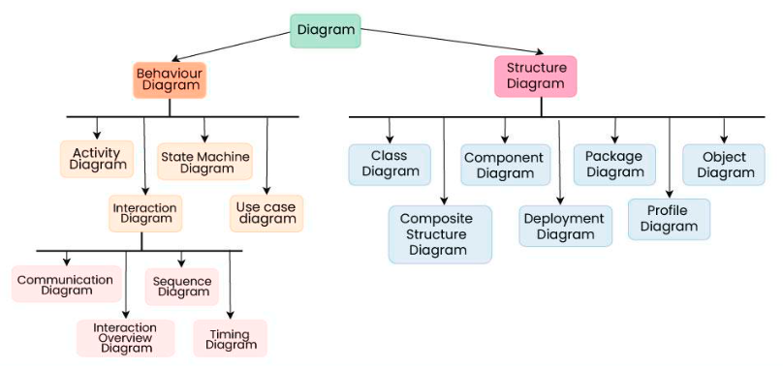
Different Types of UML Diagrams

Slide 4
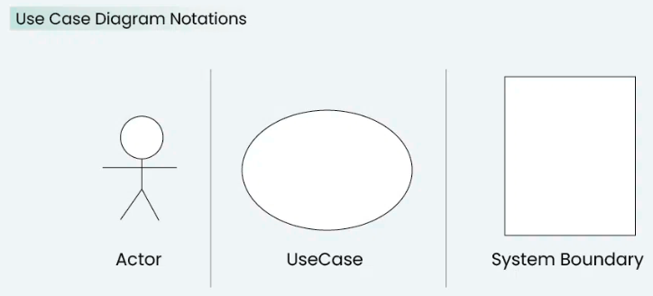
Use-case diagram
A Use Case Diagram is a type of Unified Modeling Language (UML) diagram that represents the interaction between actors (users or external systems) and a system under consideration to accomplish specific goals. It provides a high-level view of the system’s functionality by illustrating the various ways users can interact with it.

Slide 5
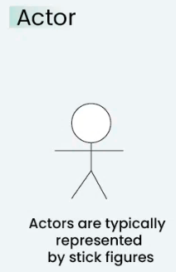
2. Use Case Diagram Notations
UML notations provide a visual language that enables software developers, designers, and other stakeholders to communicate and document system designs, architectures, and behaviors in a consistent and understandable manner.
1.1. Actors
Actors are external entities that interact with the system. These can include users, other systems, or hardware devices. In the context of a Use Case Diagram, actors initiate use cases and receive the outcomes. Proper identification and understanding of actors are crucial for accurately modeling system behavior.

Slide 6
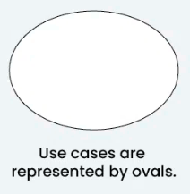
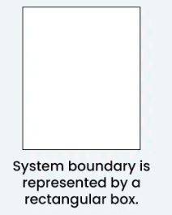
1.2. Use Cases
Use cases are like scenes in the play. They represent specific things your system can do. In the online shopping system, examples of use cases could be “Place Order,” “Track Delivery,” or “Update Product Information”. Use cases are represented by ovals.
1.3. System Boundary
The system boundary is a visual representation of the scope or limits of the system you are modeling. It defines what is inside the system and what is outside. The boundary helps to establish a clear distinction between the elements that are part of the system and those that are external to it. The system boundary is typically represented by a rectangular box that surrounds all the use cases of the system.
Purpose of System Boundary:
Scope Definition: It clearly outlines the boundaries of the system, indicating which components are internal to the system and which are external actors or entities interacting with the system.
Focus on Relevance: By delineating the system’s scope, the diagram can focus on illustrating the essential functionalities provided by the system without unnecessary details about external entities.

Slide 7
4. How to draw a Use Case diagram in UML?
Step 1: Identify Actors
Determine who or what interacts with the system. These are your actors. They can be users, other systems, or external entities.
Step 2: Identify Use Cases
Identify the main functionalities or actions the system must perform. These are your use cases. Each use case should represent a specific piece of functionality.
Step 3: Connect Actors and Use Cases
Draw lines (associations) between actors and the use cases they are involved in. This represents the interactions between actors and the system.
Step 4: Add System Boundary
Draw a box around the actors and use cases to represent the system boundary. This defines the scope of your system.

Slide 8
Step 5: Define Relationships
If certain use cases are related or if one use case is an extension of another, you can indicate these relationships with appropriate notations.
Step 6: Review and Refine
Step back and review your diagram. Ensure that it accurately represents the interactions and relationships in your system. Refine as needed.
Step 7: Validate
Share your use case diagram with stakeholders and gather feedback. Ensure that it aligns with their understanding of the system’s functionality.

Slide 9
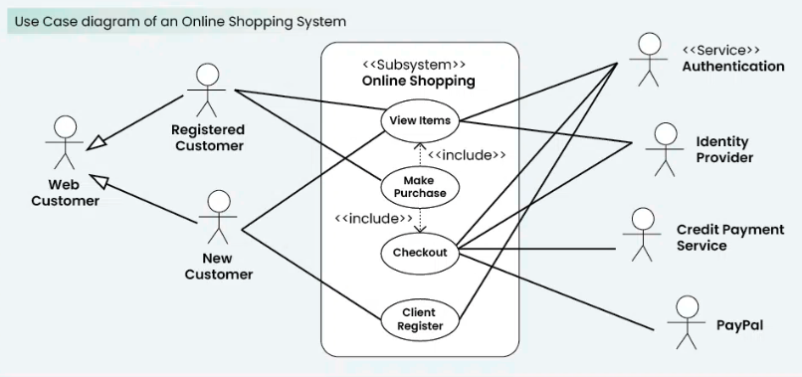
Ex: Online Shopping System:
1. Actors:
Customer
Admin
2. Use Cases:
Browse Products
Add to Cart
Checkout
Manage Inventory (Admin)
3. Relations:
The Customer can browse products, add to the cart, and complete the checkout.
The Admin can manage the inventory.

